Slide 1
Basic Loops in R Programming

Slide 2
R if Statement
The if statement consists of the Boolean expressions followed by one or more statements. The if statement is the simplest decision-making statement which helps us to take a decision on the basis of the condition.
The if statement is a conditional programming statement which performs the function and displays the information if it is proved true.
The block of code inside the if statement will be executed only when the boolean expression evaluates to be true. If the statement evaluates false, then the code which is mentioned after the condition will run.

Slide 3
The syntax of if statement in R is as follows:
if(boolean_expression) {
// If the boolean expression is true, then statement(s) will be executed.
}

Slide 4
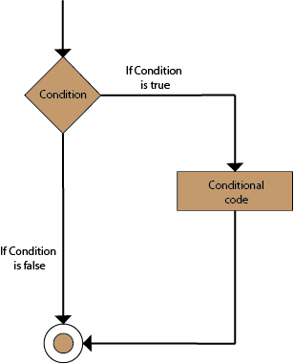

Slide 5
Example 1
a <- 33 b <- 200 if (b > a) { print("b is greater than a") }
In this example we use two variables, a and b, which are used as a part of the if statement to test whether b is greater than a. As a is 33, and b is 200, we know that 200 is greater than 33, and so we print to screen that "b is greater than a".
R uses curly brackets { } to define the scope in the code.

Slide 6
Example2
x <-24
if(x%%2==0){
print(x," is an even number")
}
if(x%%2!=0){
print(x," is an odd number")
}

Slide 7
Else If
The else if keyword is R's way of saying "if the previous conditions were not true, then try this condition":
a <- 33 b <- 33 if (b > a) { print("b is greater than a") } else if (a == b) { print ("a and b are equal") }

Slide 8
If-else statement
In the if statement, the inner code is executed when the condition is true. The code which is outside the if block will be executed when the if condition is false.
There is another type of decision-making statement known as the if-else statement. An if-else statement is the if statement followed by an else statement. An if-else statement, else statement will be executed when the boolean expression will false. In simple words, If a Boolean expression will have true value, then the if block gets executed otherwise, the else block will get executed.

Slide 9
R programming treats any non-zero and non-null values as true, and if the value is either zero or null, then it treats them as false.
The basic syntax of If-else statement is as follows:
if(boolean_expression) {
// statement(s) will be executed if the boolean expression is true.
} else {
// statement(s) will be executed if the boolean expression is false.
}

Slide 10
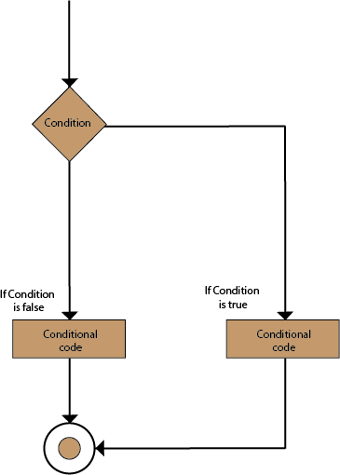

Slide 11
Example
a <- 200 b <- 33 if (b > a) { print("b is greater than a") } else if (a == b) { print("a and b are equal") } else { print("a is greater than b") }

Slide 12
# local variable definition
a<- 100
#checking boolean condition
if(a<20){
# if the condition is true then print the following
Print("a is less than 20\n")
}else{
# if the condition is false then print the following
print("a is not less than 20\n")
}
print("The value of a is", a)

Slide 13
In this example, a is greater than b, so the first condition is not true, also the else if condition is not true, so we go to the else condition and print to screen that "a is greater than b".
You can also use else without else if:
a <- 200 b <- 33 if (b > a) { print("b is greater than a") } else { print("b is not greater than a") }

Slide 14
Nested If Statements
You can also have if statements inside if statements, this is called nested if statements.
Example
x <- 41 if (x > 10) { print("Above ten") if (x > 20) { print("and also above 20!") } else { print("but not above 20.") } } else { print("below 10.") }

Slide 15
AND
The & symbol (and) is a logical operator, and is used to combine conditional statements:Example
Test if a is greater than b, AND if c is greater than a:
a <- 200 b <- 33 c <- 500 if (a > b & c > a) { print("Both conditions are true") }

Slide 16
OR
The | symbol (or) is a logical operator, and is used to combine conditional statements:
Example
Test if a is greater than b, or if c is greater than a:
a <- 200 b <- 33 c <- 500 if (a > b | a > c) { print("At least one of the conditions is true") }

Slide 17
Loops
Loops can execute a block of code as long as a specified condition is reached.
Loops are handy because they save time, reduce errors, and they make code more readable.
R has two loop commands:
while loops
for loops

Slide 18
R While Loops
With the while loop we can execute a set of statements as long as a condition is TRUE:
Example
Print i as long as i is less than 6:
i <- 1 while (i < 6) { print(i) i <- i + 1 }

Slide 19
In the example above, the loop will continue to produce numbers ranging from 1 to 5. The loop will stop at 6 because 6 < 6 is FALSE.
The while loop requires relevant variables to be ready, in this example we need to define an indexing variable, i, which we set to 1.
Note: remember to increment i, or else the loop will continue forever.

Slide 20
Break
With the break statement, we can stop the loop even if the while condition is TRUE:
Example
Exit the loop if i is equal to 4.
i <- 1 while (i < 6) { print(i) i <- i + 1 if (i == 4) { break } }

Slide 21
The loop will stop at 3 because we have chosen to finish the loop by using the break statement when i is equal to 4 (i == 4).

Slide 22
FOR LOOP
A for loop is used for iterating over a sequence:
Example
for (x in 1:10) { print(x) }

Slide 23
This is less like the for keyword in other programming languages, and works more like an iterator method as found in other object-orientated programming languages.
With the for loop we can execute a set of statements, once for each item in a vector, array, list, etc..

Slide 24
Print every item in a list:
fruits <- list("apple", "banana", "cherry") for (x in fruits) { print(x) }

Slide 25
Nested Loops
Print the adjective of each fruit in a list:
adj <- list("red", "big", "tasty") fruits <- list("apple", "banana", "cherry") for (x in adj) { for (y in fruits) { print(paste(x, y)) }

Slide 26
Thanks

